Slide 1
Operator Overloading

Slide 2
Operator overloading with Friend Function
The friend functions requires the arguments to be explicitly passed to the function and processes them explicitly, where as member function considers the first argument implicitly.
Syntax:
friend return_type operator Operator_symbol(args……)
{
//body…….
}

Slide 3
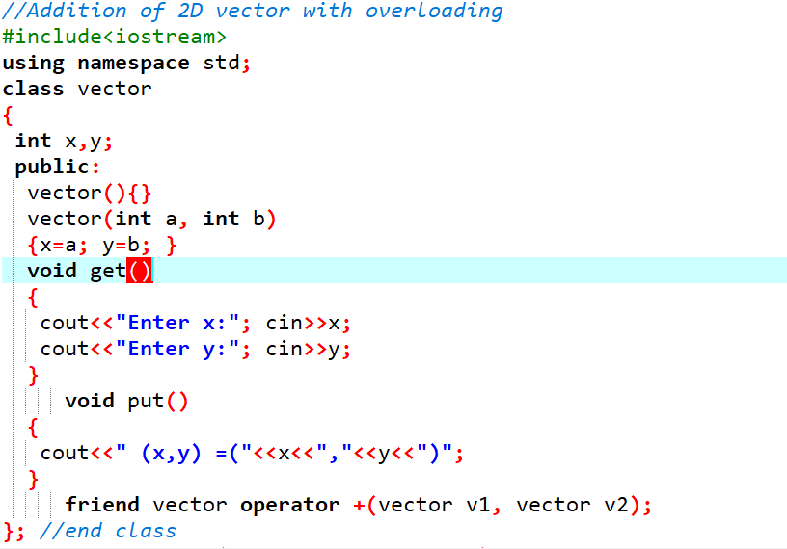

Slide 4
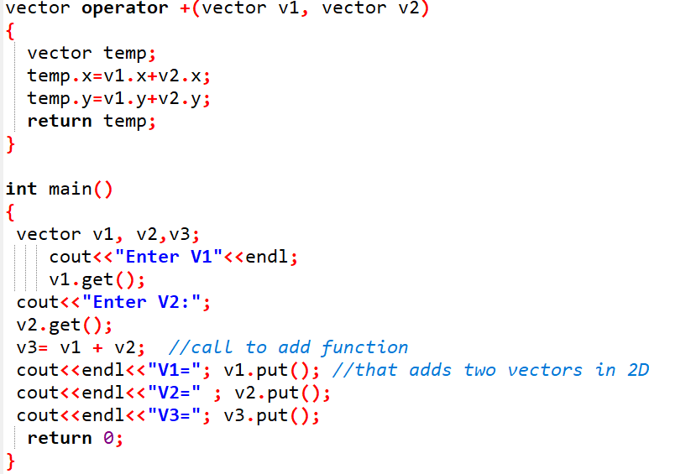

Slide 5
Data Conversion

Slide 6
Conversion between basic data types
Implicit type conversion
float weight;
int age;
weight=age;
Explicit type conversion
weight = (float)age;

Slide 7
Conversion between Objects and Basic types
The user cannot rely on the compiler to perform conversion from user-defined data types to basic data types and vice-versa, because the compiler does not know anything any thing about the logical meaning of user defined data types. To perform meaningful conversion, the user must supply the necessary conversion function.

Slide 8
Conversion basic to user-defined data types
To convert data from a basic type to a user-defined type, the conversion function should be defined in user-defined object’s class in the form of the constructor. The constructor function takes a single argument of basic data type as:
constructor(Basic_Type)
{
//converting statements
}

Slide 9
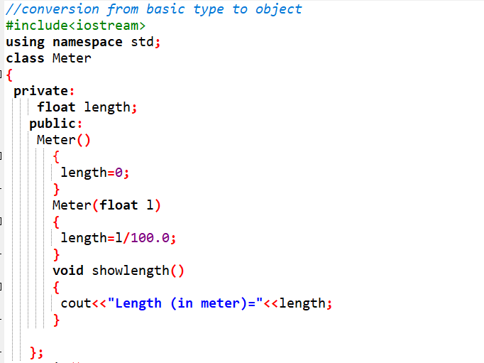

Slide 10
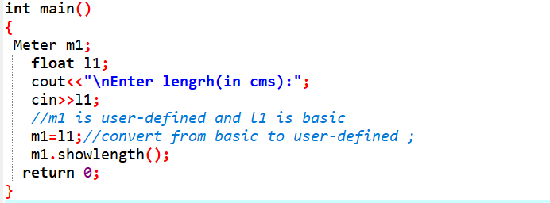

Slide 11
Conversion user-defined to basic data types
The conversion function should be defined in user-defined object’s class in the form of the operator function. The operator function is defined as an overloaded basic data type which takes no arguments. It converts the data members of an object to basic data types and returns a basic data-item.

Slide 12
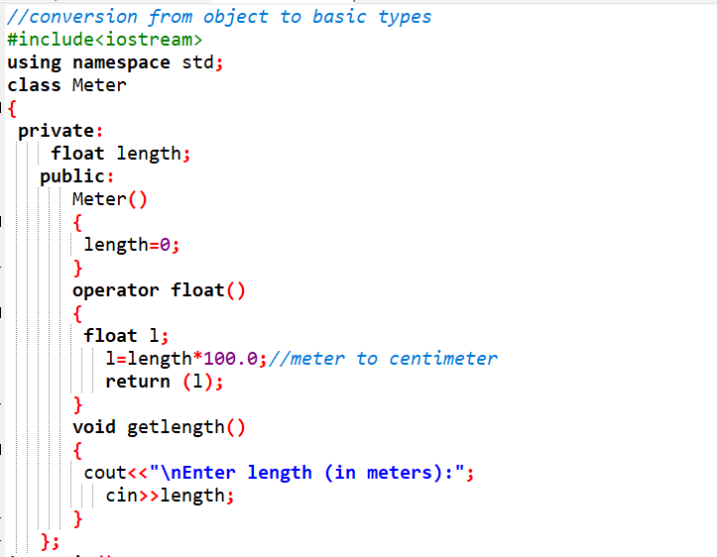

Slide 13
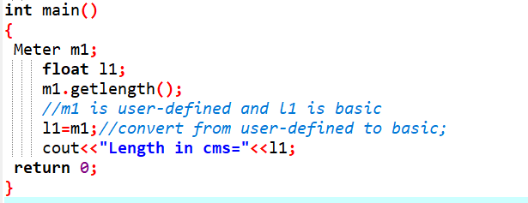

Slide 14
Conversion between objects of different classes.
The conversion method can be either defined in classA or classB depending on whether it should be one-argument constructor or an operator function.

Slide 15
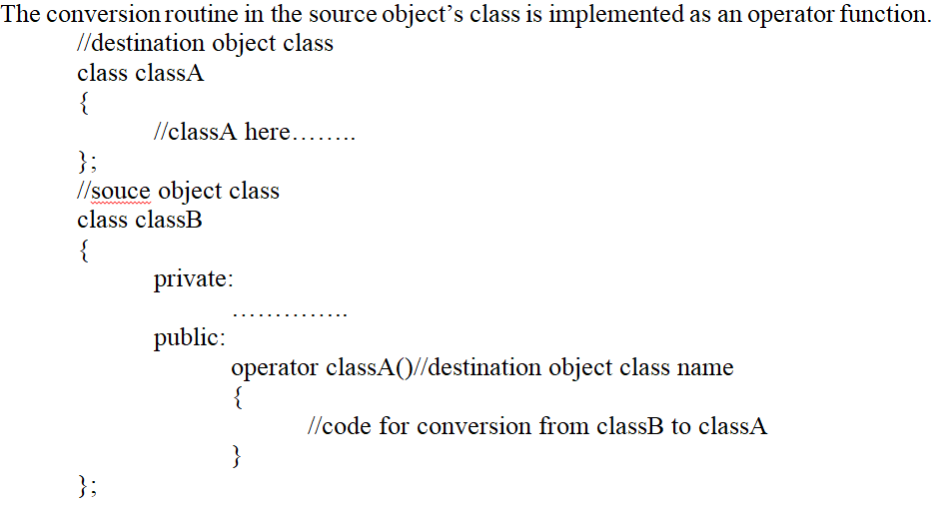
Conversion Routine in Source object: operator function

Slide 16
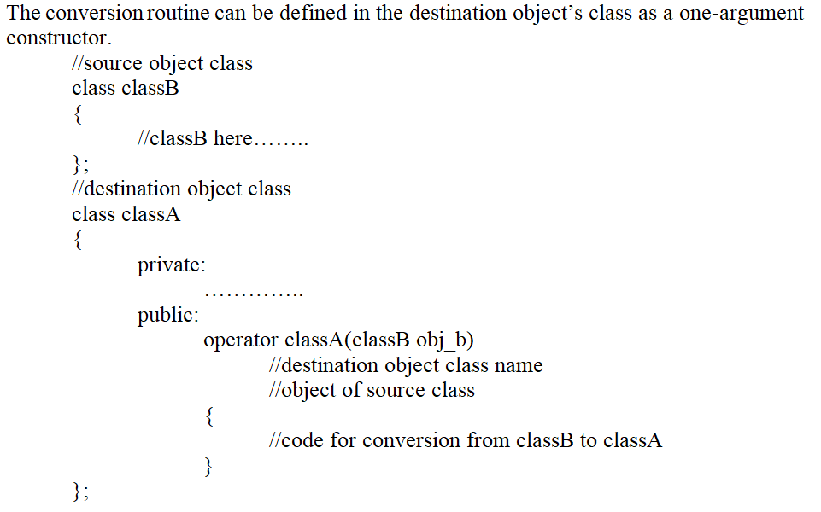
Conversion Routine in Destination Object: constructor function

